Slide 1

AI for New Students
Student Chatbot to Promote AI for All

Slide 2
Agenda
01
02
03
04
Problem Statement
Overview
Value
Experience of the project

Slide 3




The Problem: Transitioning to New Environments
More than 500k people are accepted to universities each year
62% of students live away from home
1 in 5 students report concerns about living costs
Over 40% of students worry about interpersonal relationships

Slide 4
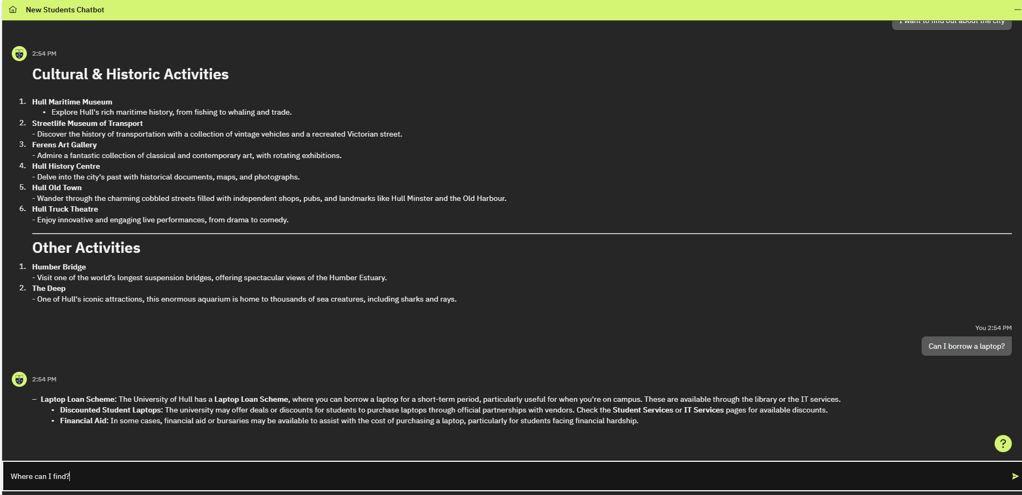
The Solution: Our Chatbot
A webapp chatbot built using IBM Watsonx Virtual Assistant, IBM Cloud and React.
This is able to guide students with the necessary information they will need to access when transitioning to university

Slide 5
Try It Yourself
Scan The QR Code
Try one of the preset prompts for key student user stories
Try to ask independent questions as a student new to university would
Tutal powinien znaleść się
QR code z linkiem do projektu.
QR code jest optional.
QR skasowany w ramach anonimizacji przykładu.

Slide 6
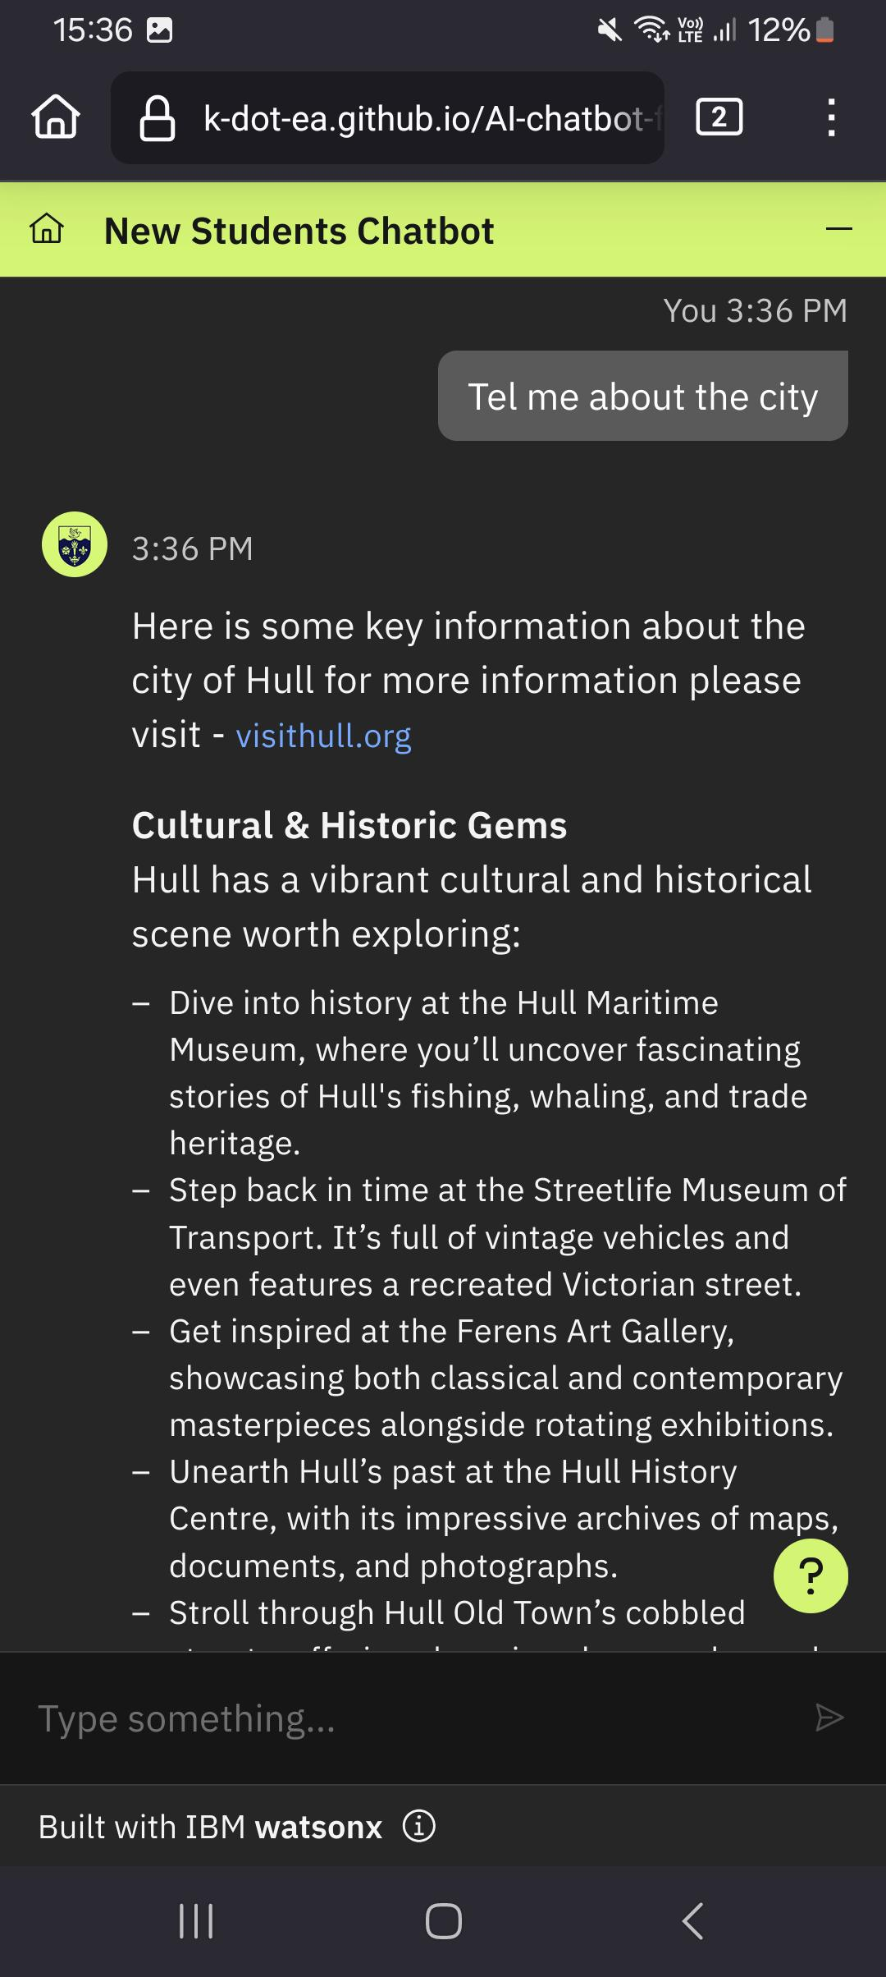
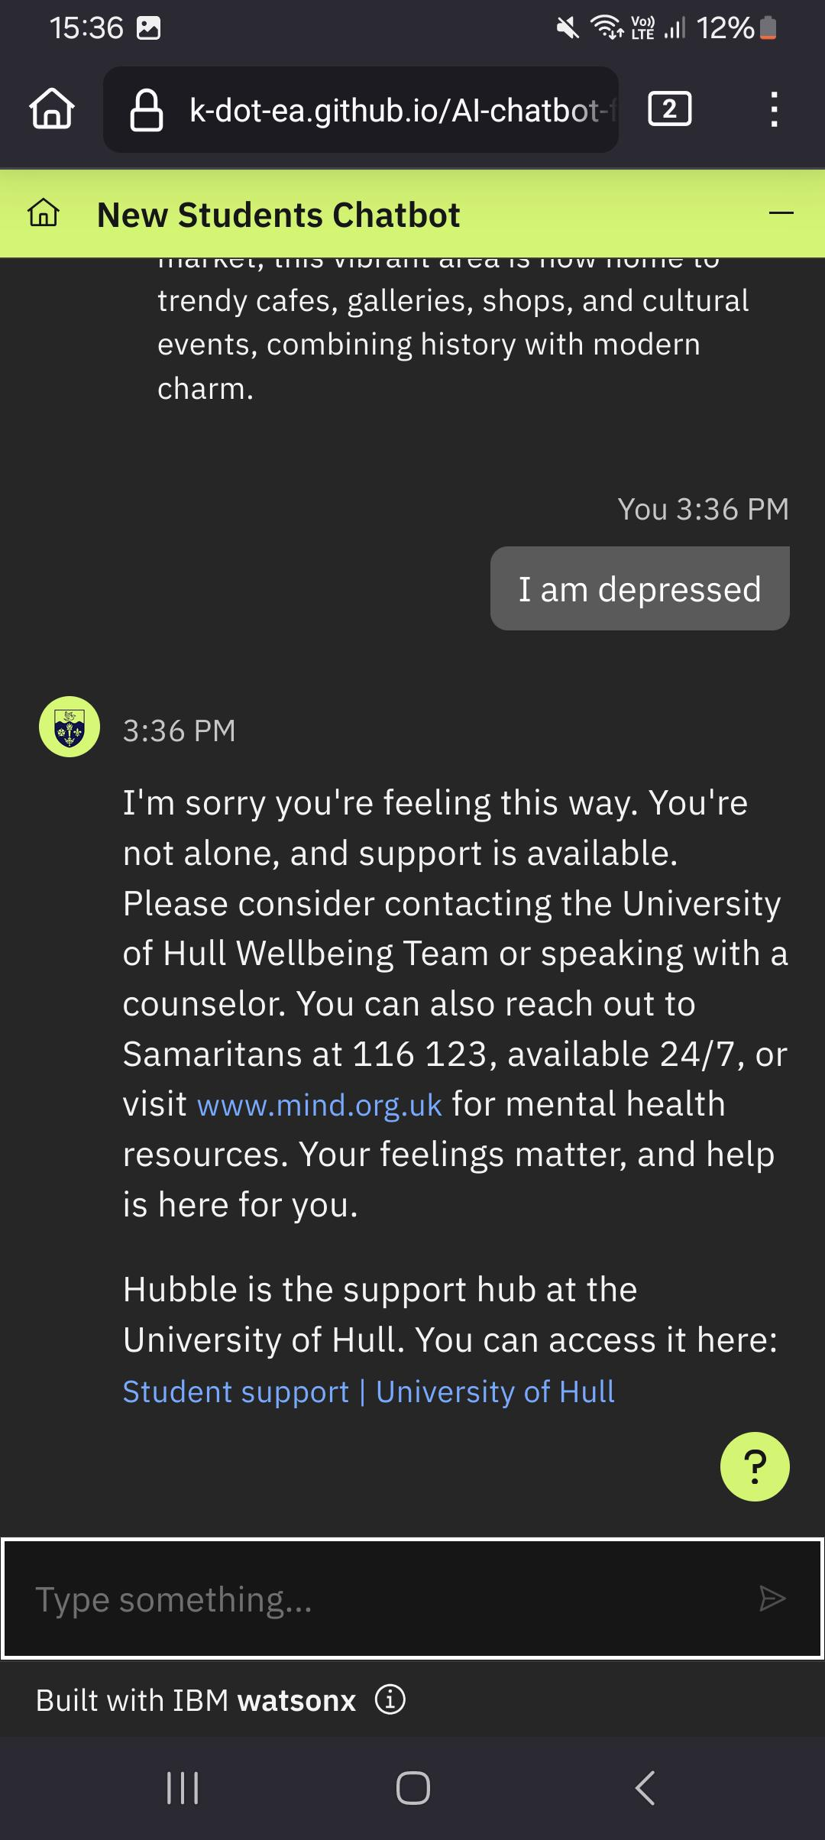
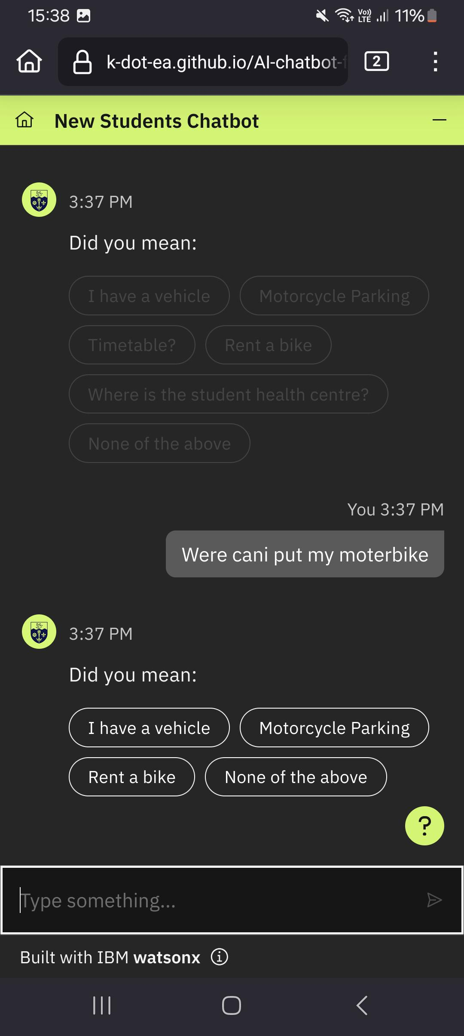
The Value of Our Chatbot
1
Students new to the city can learn about the venues available
2
Danger words are used to detect students in crisis
3
LLM technology catches synonyms and spelling mistakes in user messages
4
Potential future rebranding to other universities

Slide 7
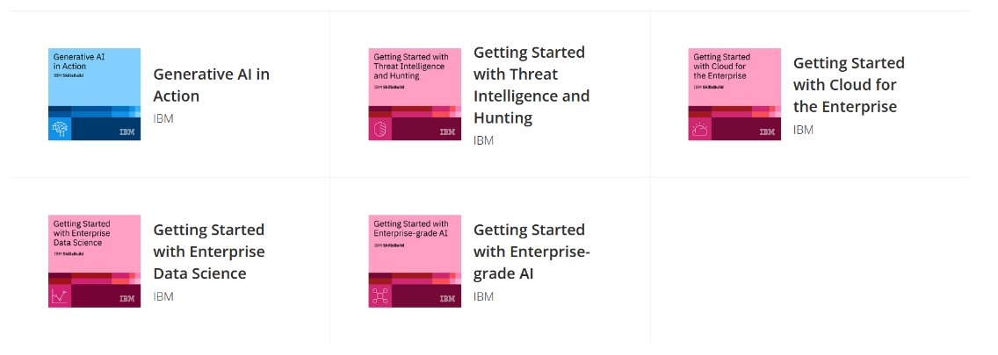

Experience of the project
How we Learned to Work
How did we learn the skills necessary for the project success?
Provided us with the experience and motivation to apply for further opportunities
A powerful opportunity to develop meaningful connections within IBM
Exposure to the IBM culture of learning and growth through SkillsBuild

Slide 8
Thank You
For any questions feel free to contact
<email>
Informacje o zespole

